Slide 1

OWASP’s Ten Most Critical Web Application Security Vulnerabilities
Abhishek Gautam
Building a secure CYBERSPACE

Slide 2
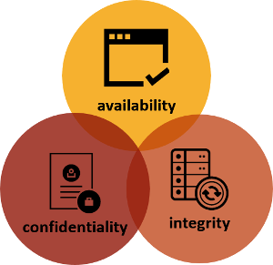
What is Cyber Security?
Cyber security is concerned with the risk of malpractices in the CYBERSPACE which involves PEOPLE, PROCESS AND TECHNOLOGY.
The problem? With over 2.5 quintillion bytes of data being produced around the world daily, IS OUR DATA REALLY SAFE?
SECUIRTY deals with 3 primary issues called the CIA traid
CONFEDENTIALITY assurance that only authorized user may access a resource.
AVAILIBILTY assurance that authorized user may access a
resource when requested.
INTEGRITY assurance that resource has not been modified

Slide 3

WHAT IS OWASP?
NOT FOR PROFIT worldwide charitable organization focused on improving the security of the application software.
Started on September 9, 2001 by Mark Curphey
Mission:
To make application security visible, so that people and organization can make informed decisions about true application risk
Everyone is free to participate in OWASP

Slide 4
WHAT IS WEB SECUIRTY?
Almost everything relies on computers and internet now.
TRANSPORTATION(navigation system, vehicle systems)
MEDICATION(medical records, equipment)
SHOPPING(online stores, credit cards)
Entertainment(movies, songs)
Communications
The web was designed as a trusted environment. It is NOT that anymore.
WEB SECUIRTY deals with security of websites, web applications and web services.
Securing the “custom code” that drives a web application, Securing libraries
Securing backend systems and Securing application servers

Slide 5
Why Should I care?
Let’s just think this through…
How likely is a successful web application attack?
Stunningly prevalent
Easy to exploit without special tools or knowledge
Little chance of being detected
Hundreds of thousands of developers, tiny fraction with security
Consequences?
Corruption or disclosure of database contents
Root access to web and application servers
Loss of authentication and access control for users
Defacement
Secondary attacks from your site
Web Application Security is just as important as Network Security!

Slide 6
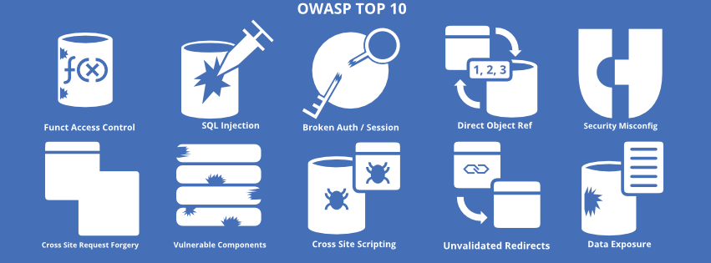
The OWASP Top 10

Slide 7


Slide 8
Injection Attacks
INJECTION is an attacker’s attempt to breach into an application by giving commands to it such that it will change the meaning in which the commands are interpreted and then change the course of execution into an unexpected manner. It is one of the most common security risks in web applications…
Approximately we have around 42 types of SQL infection attacks!
E.g.: Union based SQL Injection, Error Based SQL Injection, Post Parameter Injection, Blind SQL Injection, etc.

Slide 9
Technical and Business Impacts of Injection Attacks?
TECHNICAL IMPACTS: “SEVERE”
Injection attacks can result in data loss or corruption, lack of accountability, or denial of access. It can sometimes lead to complete host takeover.
BUISNESS IMPACTS: “APPLICATION/BUISNESS SPECIFIC”
For the business impacts of injection attacks consider the business value of the affected data and the platform running the interpreter. All data could be stolen, modified or deleted and could affect the business reputation

Slide 10
How to prevent Injection attacks?
Reducing the use of GET methods
Saving the Credentials in salted encryption form.
Use of HTTPS instead of HTTP
Proper validation on the database inputs from the end users
Static query Statements
Least Privilege
Code Verification
Web Application Gateway
Sql Driver Proxy
Development Phase
Production Phase

Slide 11

BROKEN AUTHENTICATION AND
SESSION MANAGEMENT
Application functions related to authentication and session management are often NOT IMPLEMENTED CORRECTLY, allowing attackers to COMPROMISE passwords, keys, session tokens, or to exploit other implementation flaws to assume other users’ identities.
In simpler teams if any unauthorized person may be a client or any attacker is successful in accessing any page on the website or any other user’s data without authentication by providing the direct reference to the page or by manipulating some id or value of URL the website lies under BROKE AUTHENTICATION AND SESSION MANAGEMENT

Slide 12
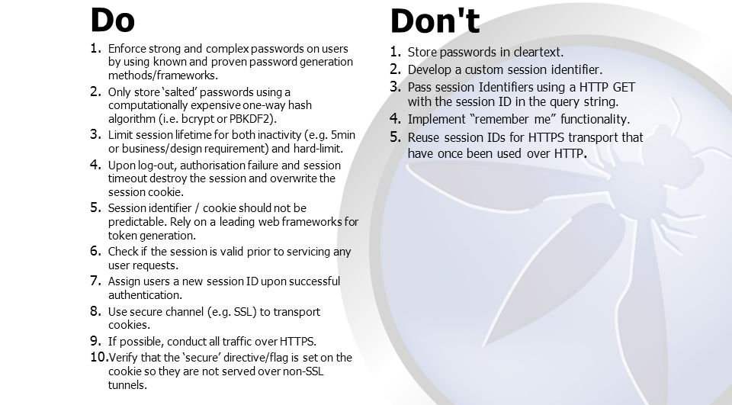

Slide 13
Technical and Business Impacts of Broken
Authentication and Session management attacks?
TECHNICAL IMPACTS: “SEVERE”
Such flaws may allow some or even all accounts to be attacked. Once successful the attacker CAN DO ANYTHING THE VICTIM was allowed to do most frequently the Privileged accounts are targeted.
BUISNESS IMPACTS: “APPLICATION/BUISNESS SPECIFIC”
Consider the business value of the affected data or application functions. Also consider the business impact of public exposure of the vulnerability.

Slide 14

PREVENTION
Use STRONG AUTHENTICATION and SESSION MANAGEMENT CONTROLS.
PROVIDE SIMPLE INTERFACE for the developers to avoid common errors.
Session ID’s should NOT BE EXPOSED IN THE URL.
Passwords, Session ID’s, and other credentials should be ENCRYPTED when sent over networks.
APPLICATION’S TIMEOUTS should be implemented and used properly.
6. Sessions and tokens should be used and DESTROYED PROPERLY IN A GIVEN TIME STAMP.

Slide 15
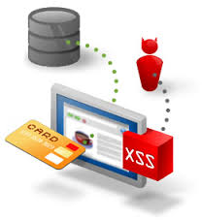
CROSS SITE SCRIPTING (XSS)
XSS
Reflected
Stored
Found mainly in DYNAMIC WEBSITES
If any website or any web application takes any kind of executable input from any unauthorized visitor and sends it to a web browser without proper validation or escaping then we can say that the website or application is vulnerable to XSS attack.
It ALLOWS attackers to EXECUTE SCRIPTS in the VICTIM’S BROWSER which can
HIJACK USER SESSIONS, DEFACE WEBSITES, MANIPULATE THE FRONT END OF THE
WEBSITE, OR REDIRECT THE USER TO MALICIOUS SITES.

Slide 16
Types of XSS
Reflected XSS
Stored XSS
This type of XSS has a PERMANENT EFFECT. If the input field is attached to the database then we can say that it’s a stored XSS.
In this type of attack an attacker inputs a malicious java script code to steal cookies of all the visitors of the website who visits for online shopping or banking etc.
This type of XSS has a TEMPORARY EFFECT. It effects only a particular user’s browser and does not remains permanently for every visitor of the website.
In this type of attack any attacker can add a form on the vulnerable link and send a Input form with details like Name, Credit Card no, Password , PINCODE etc.

Slide 17
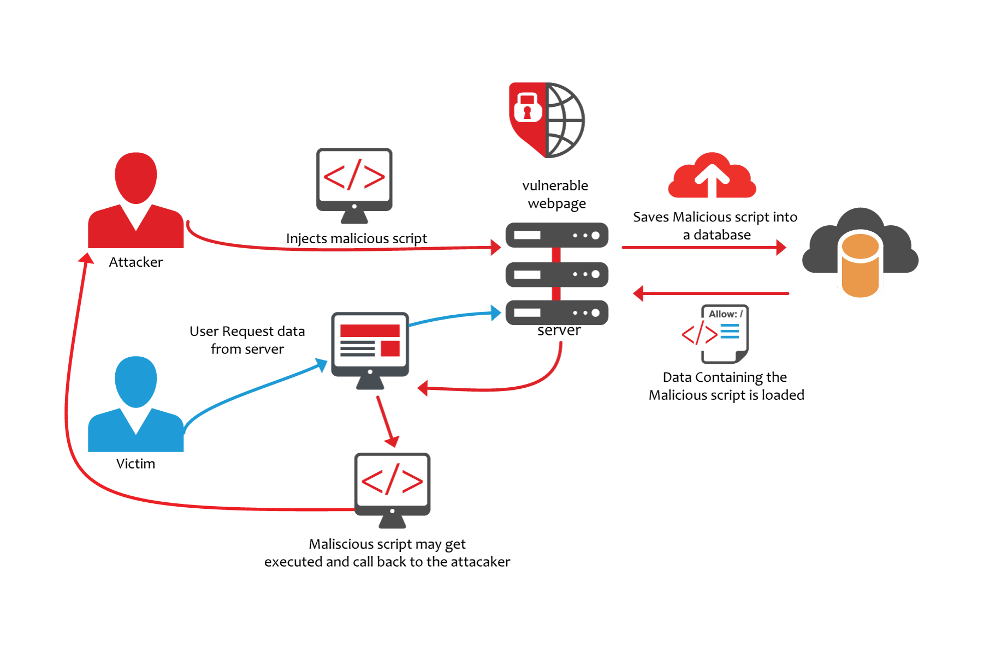
Exploiting XSS

Slide 18
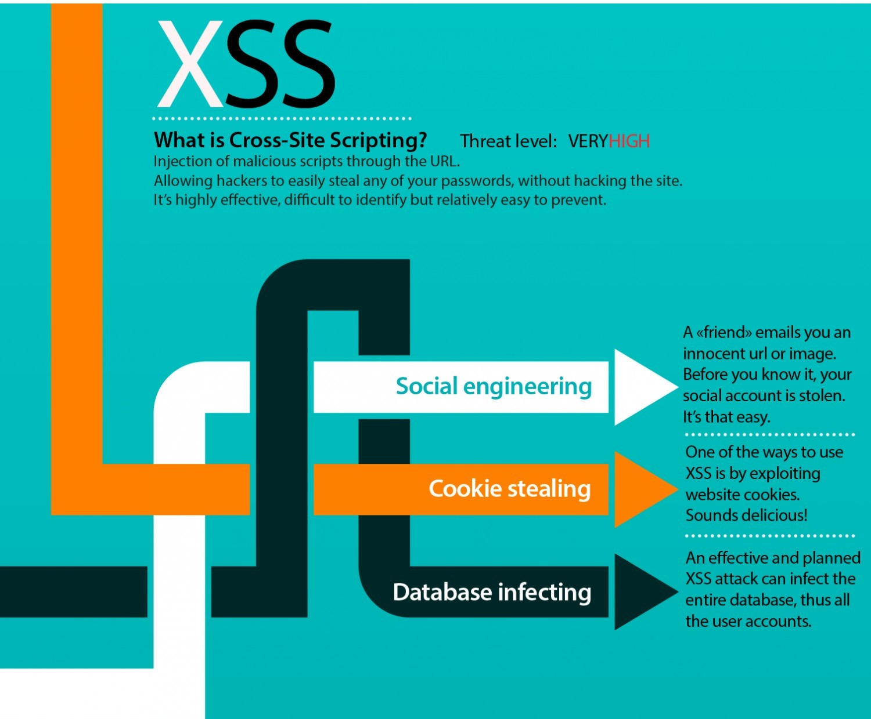

Slide 19
Technical and Business Impacts of XSS Attacks?
TECHNICAL IMPACTS: “Moderate”
Attackers can execute scripts in a victim’s browser to hijack user’s sessions, deface websites, insert hostile content, redirect users to any fake page, hijack user’s browser with the help of malwares etc.
BUISNESS IMPACTS: “APPLICATION/BUISNESS SPECIFIC”
Consider the business value of the affected system and the data it processes. Also consider the business impact of public exposure of the vulnerability.

Slide 20
Prevention From
Don’t Output User Supplied Input ☺
Whitelist Inputs
Encoded Output(Using OWASP ESAPI)
Use libraries like owasp’s Antisamy
Consider Content Security Policy (CSP) to defend against XSS across your entire site.
For rich content consider auto-sanitization libraries

Slide 21

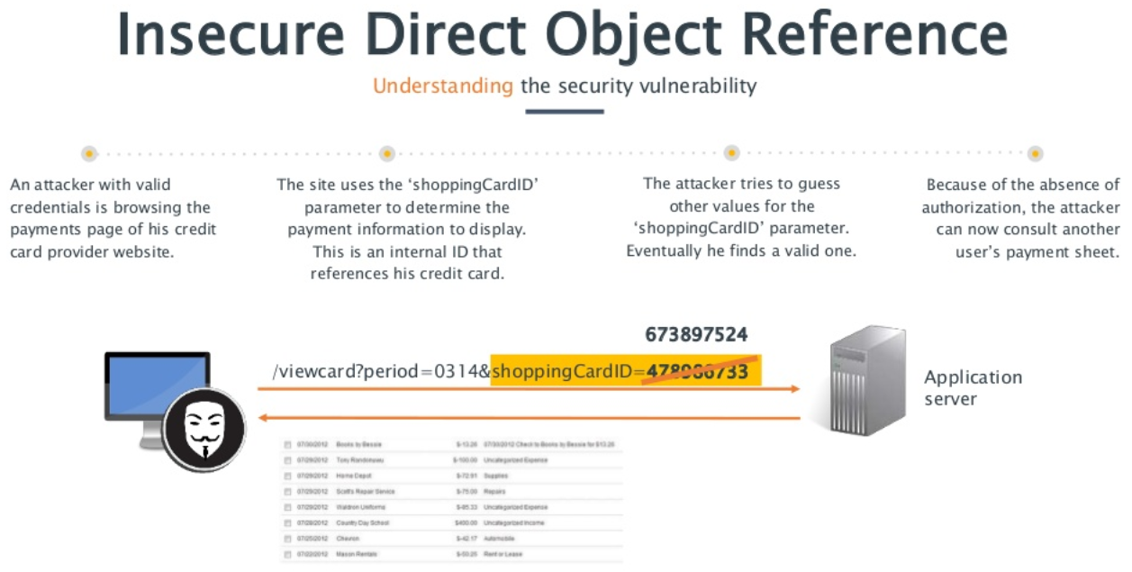
.

Slide 22
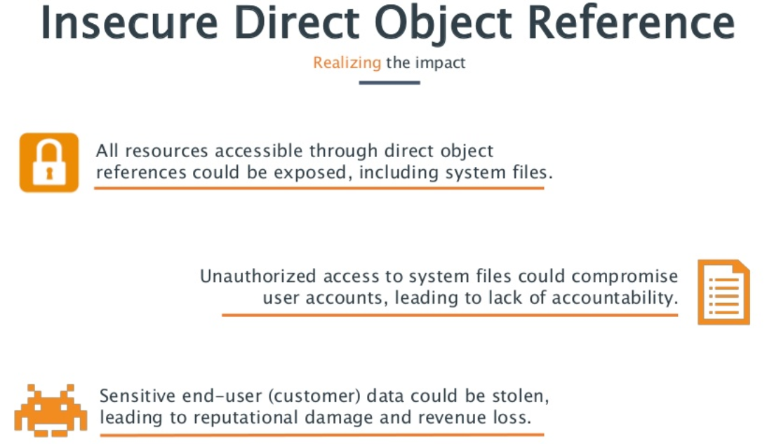

Slide 23
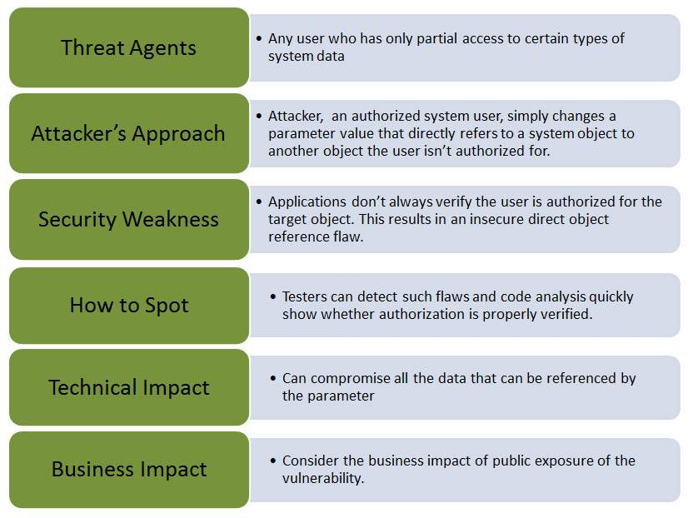

Slide 24
Prevention
The values supplied by the user should be carefully examined through an access control function to ensure that the user is authorized for the requested object.
Use per user or session indirect object references, it prevents attackers from directly targeting unauthorized resources

Slide 25

SECURITY MISCONFIGURATION
Good security requires
HAVING A SECURE CONFIGURATION DEFINED AND DEPLOYED
for the application, frameworks, application server, web server, database server, and platform. Secure settings should be defined, implemented, and maintained, as defaults are often insecure. Additionally, software should be kept up to date.
In a simple words any firewall or web application’s security settings should be configured by the administrator itself as
THE DEFAULT CONFIGURATION IS ALREADY KNOW TO EVERY ATTACKER ALONG WITH ITS FLAWS, SO USING DEFAULT CONFIGURATION MAY PUT YOUR WEB APPLICATION TO DANGER.

Slide 26
Technical and Business Impacts of
Security Misconfiguration ?
TECHNICAL IMPACTS: “Moderate”
The vulnerable system should be completely compromised without your knowledge. All the data in it could be stolen or modified.
BUISNESS IMPACTS: “APPLICATION/BUISNESS SPECIFIC”
The system could be completely compromised without the administrator’s knowledge all of the data in it could be stolen or modified slowly over time.
Recovery costs could be expensive.

Slide 27
Preventions
Firewall configuration should not be kept at its default state, it should be configured manually.
A strong application architecture that provides effective, secure separation between components should be established.
Periodic scans and audits should be done to detect future misconfiguration and missing patches.

Slide 28

Sensitive Data Exposure
Many web applications do not properly PROTECT SENSITIVE DATA, such as credit cards, tax IDs, and authentication credentials.
Attackers may steal or modify such weakly protected data to conduct credit card fraud, identity theft, or other crimes.
SENSITIVE DATA DESERVES EXTRA PROTECTION such as encryption at rest or in transit, as well as special precautions when exchanged with the browser.

Slide 29
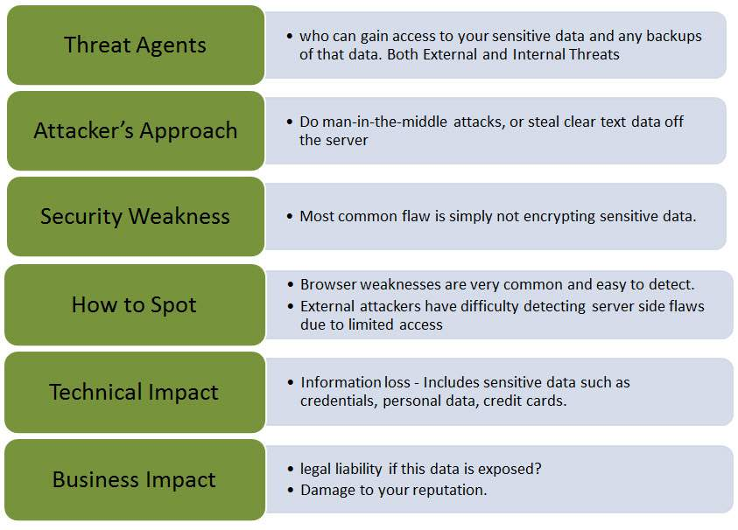

Slide 30
Technical and Business Impacts of
Sensitive Data Exposure?
TECHNICAL IMPACTS: “Severe”
Frequent failures compromises all the data that should have been protected. Typically these information includes sensitive data such as health records, credentials, personal data, credit card details, secret projects etc.
BUISNESS IMPACTS: “APPLICATION/BUISNESS SPECIFIC”
The business value of the lost data and impact to the organization’s reputation should be considered. The liability of the organization should be kept in mind before the data is exposed.

Slide 31
Prevention
For all sensitive data following the hints below can reduce the vulnerability to data exposure.
USE ENCRYPTION for all the sensitive data at rest or in transit to defend against threats regarding data exposure.
SENSITIVE DATA SHOULD NOT BE STORED UNNECESSARILY it should be discarded as soon as its work is over because data you do not possess cannot be stolen.
PASSWORDS SHOULD BE STORED WITH SPECIFIC PASSWORD PROTECTION ALGORITHM and also using salted algorithms (mixture of your own hashing algorithm and any standard password protection algorithm available).
AUTOCOMPLETE FUNCTIONS ON FORMS SHOULD BE DISABLED in order to prevent them from collecting sensitive data also disable caching for pages that contain sensitive data.

Slide 32
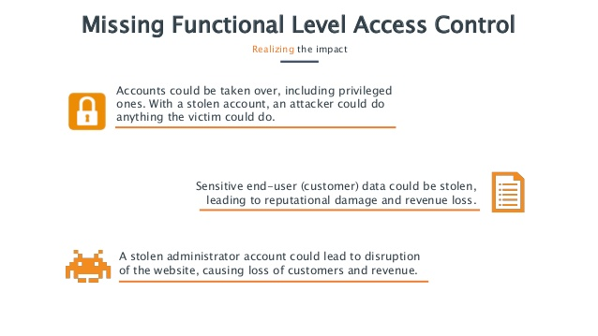

Missing functional
access control

Slide 33
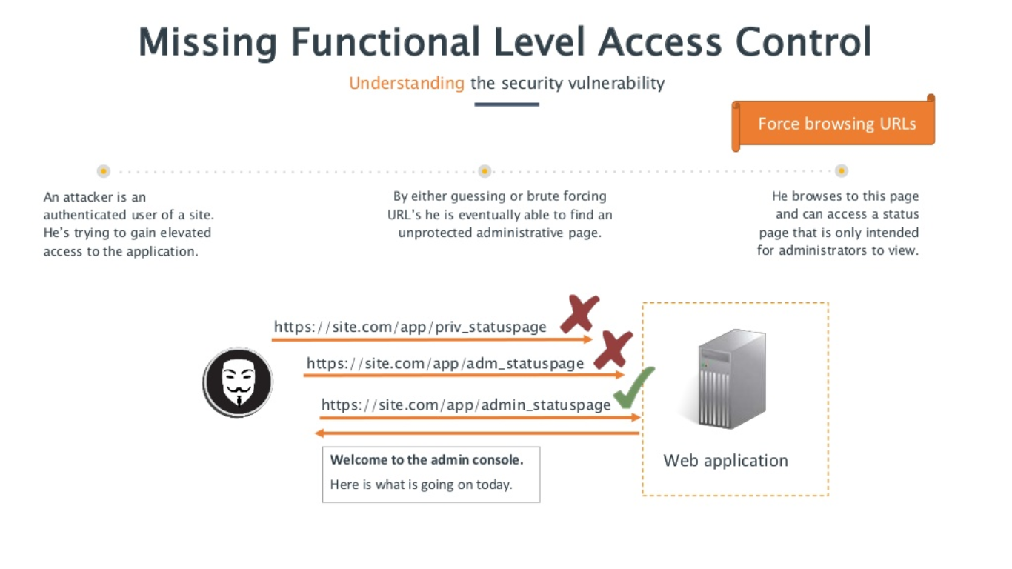

Slide 34
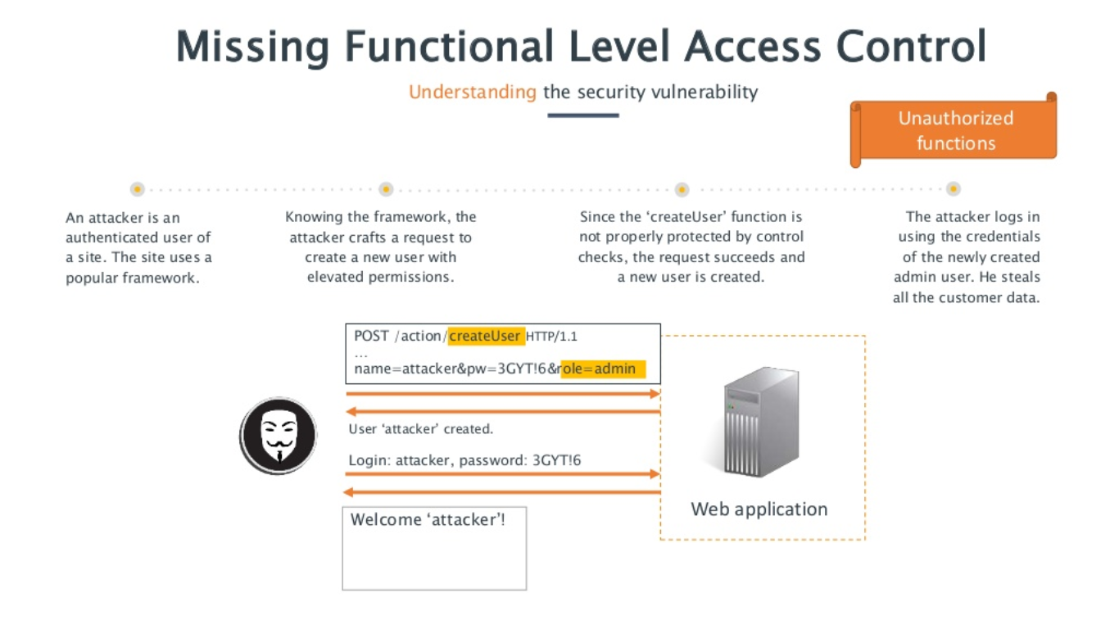

Slide 35
Technical and Business Impacts of
Missing functional level access control
TECHNICAL IMPACTS: “Moderate”
Such flaws allow attackers to access unauthorized functionality. Administrative functions are key targets for this type of attack.
BUISNESS IMPACTS: “APPLICATION/BUISNESS SPECIFIC”
The business value of the exposed functions and the data they process should be considered. Also the impact to the organization’s reputation should be considered if this vulnerability becomes public.

Slide 36
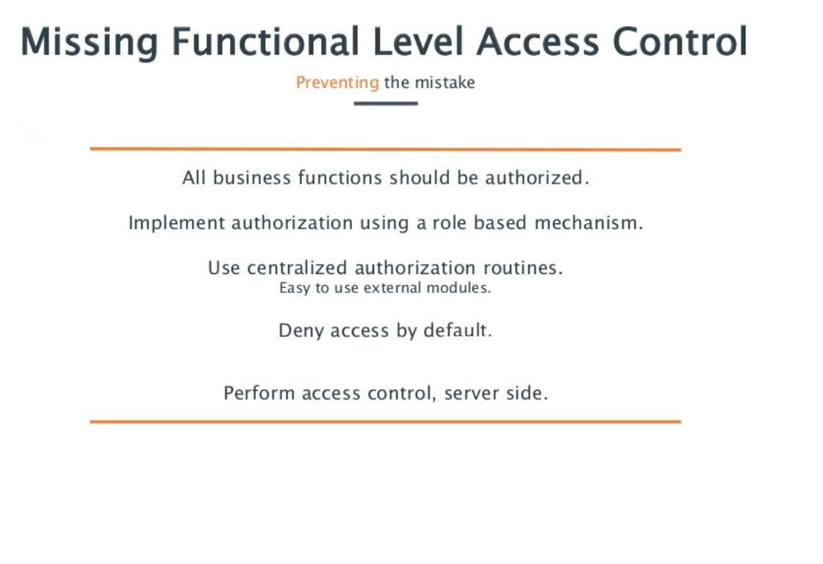

Slide 37

CROSS SITE REQUEST FORGERY (CSRF)
Cross-site request forgery, or CSRF, takes ADVANTAGE OF A USER’S AUTHENTICATED BROWSER STATE to make requests on their behalf from a malicious website. For request handlers that do not require an additional piece of authenticating information (e.g. a CSRF token) this could lead to the unauthorized modification of a user’s data or settings.
CSRF takes advantage the fact that most web apps allow attackers to predict all the details of a particular action. Because browsers send credentials like session cookies automatically, attackers can create malicious web pages which generate forged requests that are indistinguishable from legitimate ones.

Slide 38
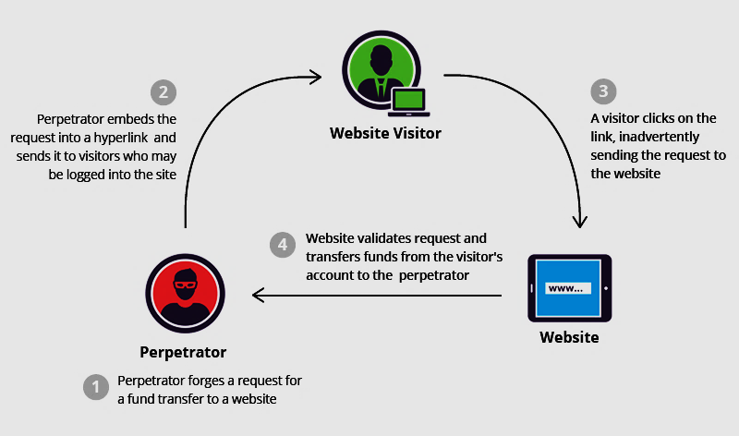

Slide 39
Technical and Business
Impacts of CSRF
TECHNICAL IMPACTS: “Moderate”
Attackers can easily trick victims into performing any state changing operation the victim is authorized to perform. E.g. updating account details, making purchases, logout and even login.
BUISNESS IMPACTS: “APPLICATION/BUISNESS SPECIFIC”
The business value for the affected data or application functions should be considered. Consider the impact on the organization’s reputation.

Slide 40
PREVENTION
USE OF TOKENS SHOULD BE AT A MINIMUM and should be unique, one per user’s session.
The tokens should BE IMPLEMENTED IN HIDDEN FIELDS in order to avoid its exposure and inclusion in the URL.
RE AUTHENTICATION FOR THE USER in order to prove that they are authentic user can also prevent CSRF attacks.

Slide 41
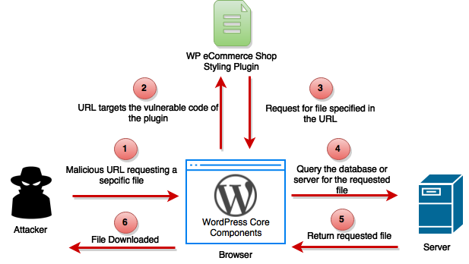
USING COMPONENTS WITH
KNOWN VULNERABILITIES
Components, such as libraries, frameworks, and other software modules, almost always run with full privileges. If a vulnerable component is exploited, such an attack can facilitate serious data loss or server takeover. Applications using components with known vulnerabilities may undermine application defenses and enable a range of possible attacks and impacts.

Slide 42
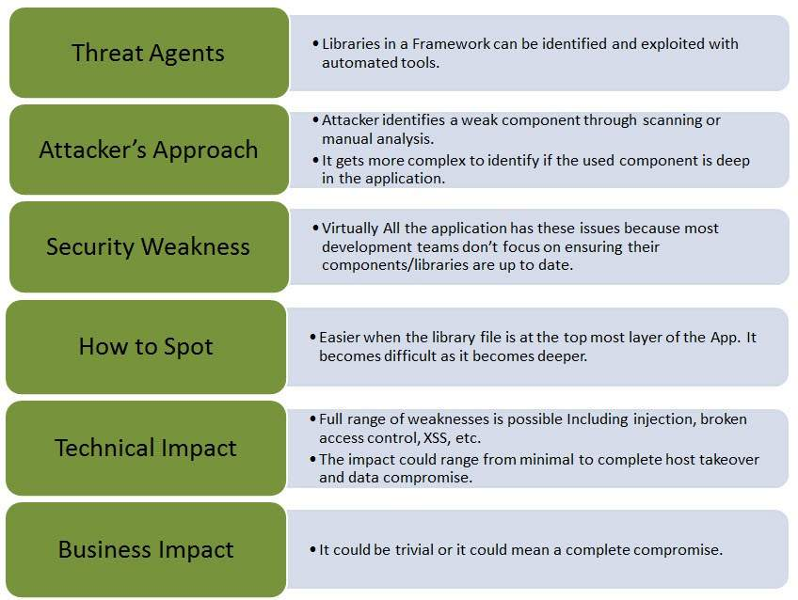

Slide 43
PREVENTION
The best option is not to use any components that are not developed by any trusted source but it’s not very feasible. Vulnerabilities for the old versions of most of the components are not released by its organization so upgrade these components or use any other of similar kind which is having all of its security patches up-to-date.
The software development phase should include:-
IDENTIFICATION OF ALL COMPONENTS AND THE VERSIONS that are used including all the dependencies.
The SECURITY OF THESE COMPONENTS in public databases, project mailing lists, security mailing lists, should be monitored and kept updated.
SECURITY POLICIES governing the use of components should be implemented.

Slide 44

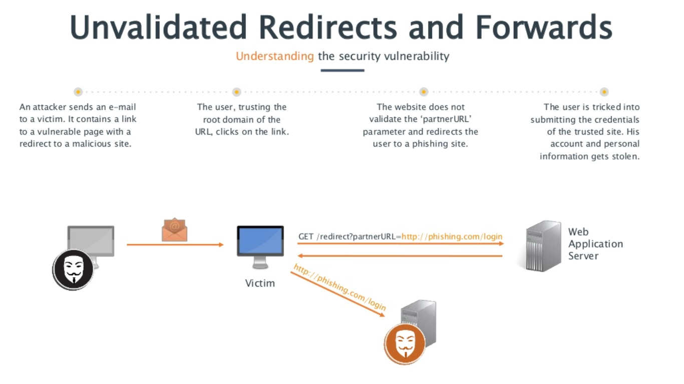

Slide 45
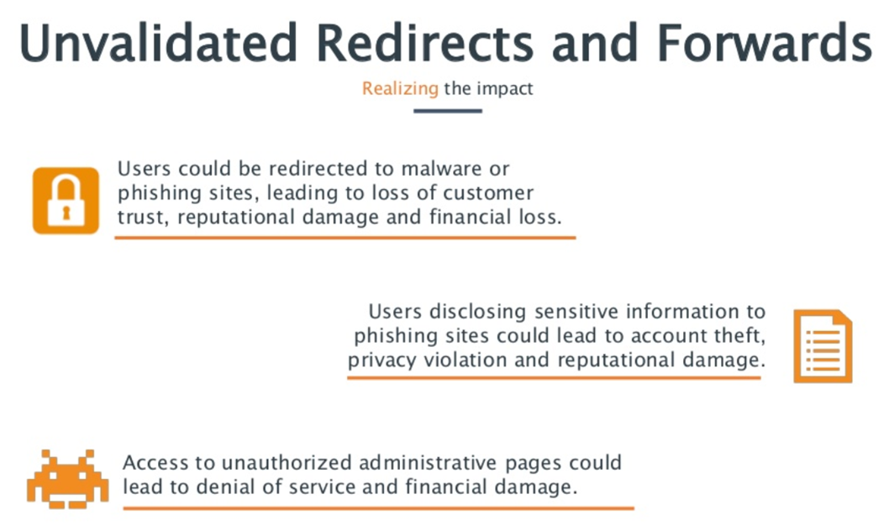

Slide 46
Technical and Business Impacts of
unvalidated redirects and forwards
TECHNICAL IMPACTS: “Moderate”
Such redirects may attempt to install malware or trick victims into disclosing passwords or other sensitive information. Unsafe forwards may allow access control bypass.
BUISNESS IMPACTS: “APPLICATION/BUISNESS SPECIFIC”
Consider the business value of retaining the users’ trust also consider the impacts if they get owned by malware or if attackers get access to internal functions.

Slide 47
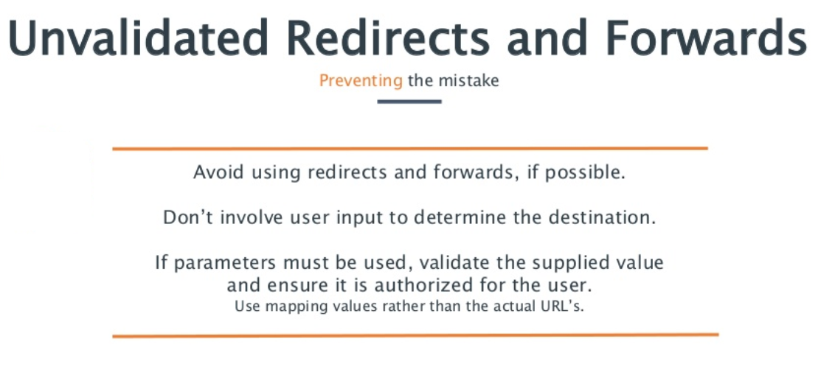

Slide 48
THANK YOU
ANY QUESTIONS?

